Slide 1
Data Pre-Processing and Feature Engineering
In Progress

Slide 2
Real Data Is Often Messy!
Real world data is often “messy” and unsuitable for many common types of analysis
Common issues include:
Missing values
Duplicate values
Outliers
Errors
Skewness / Kurtosis
Non-numerical data

Slide 3
First Step: Check Your Data
Take a look at your data in the following ways and make sure it looks the way you think it should
Show the top (and bottom?) rows of the data for a quick visual inspection (df.head() / df.tail())
Get counts, data types, and missing value counts (df.info())
Get summary statistics (df.describe())
Note which variables may be in need of transformation, correction, alteration, etc.

Slide 4
Data Types
Different types of data are processed differently by software
If “3” is treated as a “string” (text), 3x3 = 333
If “3” is treated as an “int” (integer)” 3x3 = 9
Make sure numerical variables are imported / loaded as numerical!
Other types:
Float
Boolean
Categorical
Datetime
Object

Slide 5
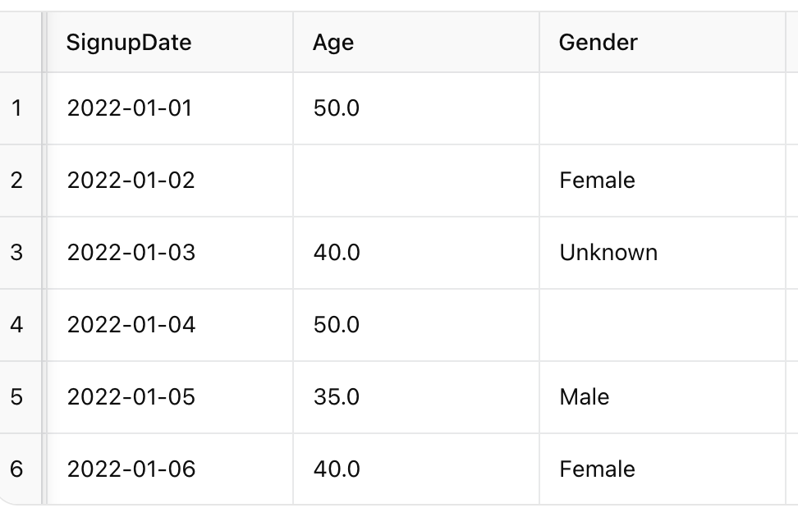
Missing Values
MCAR (Missing Completely at Random): Missingness is unrelated to any variable (e.g., a survey response accidentally not recorded).
-Simple imputation or deletion is often fine.
MAR (Missing at Random): Missingness depends on observed variables (higher-income customers skip income questions).
-Imputation methods that consider other variables work best (such as multiple regression)
MNAR (Missing Not at Random): Missingness depends on unobserved data (people with low income intentionally don’t report it).
-Requires domain knowledge or advanced techniques.

Slide 6
Missing Values (continued)
Deletion Methods
Listwise Deletion (Drop Rows): Remove rows with missing values. Best when missing values are rare (<5%) and data is MCAR.
Risk: May reduce sample size and statistical power.
Column Deletion: Drop columns if they have too many missing values (>40%?)
Imputation Methods:
Mean/Median Imputation: Replace missing numeric values with column mean or median.
Mode Imputation (Most Frequent): Good for categorical variables.
Forward/Backward Fill (Time Series): Fill using adjacent values:
Domain-Specific Imputation:Use known business rules (missing income = replace with median income of customers in the same region).
Predictive Imputation: Use models (regression or KNN) to estimate missing values based on other variables.

Slide 7
Duplicate Values
Duplicates may or may not be a problem
Not a problem: Same customer, different transaction
Problem: Same customer and transaction, counted multiple times (due to error?)
Fixes:
Drop duplicate rows
Aggregate duplicate rows if some values are same but others aren’t (for instance, same transaction but different totals)

Slide 8
Outliers
Outliers can:
Distort mean and variance
Heavily influence regression
Create misleading conclusions
Common detection methods:
Z Scores: Abs(Z)>3
IQR: Q1- 1.5x IQR and Q3 + 1.5 x IQR
What to do?
If an error, remove it!
If meaningful, keep it.
Model with and without.
Transform
Cap / Winsorize
Don’t blindly remove. Extreme values could matter a lot. Might be your most valuable customer!

Slide 9
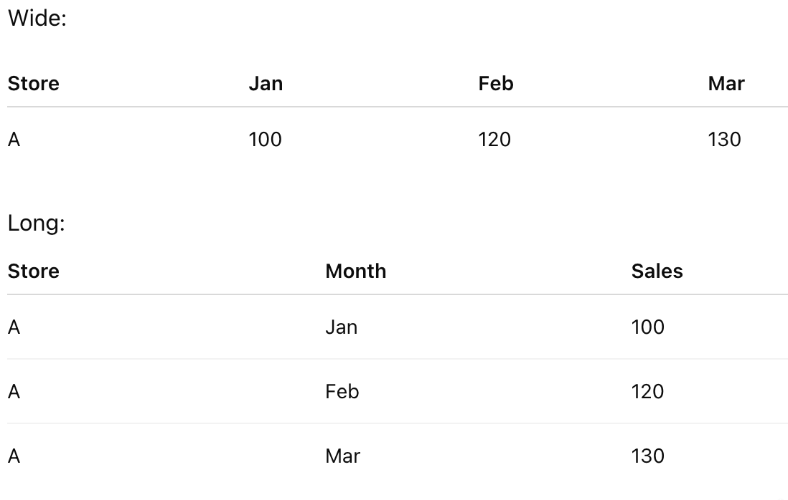
Reshaping
Wide:
One row per entity
Multiple columns for related values
Long:
Multiple rows per entity
One column stores values, another stores labels

Slide 10
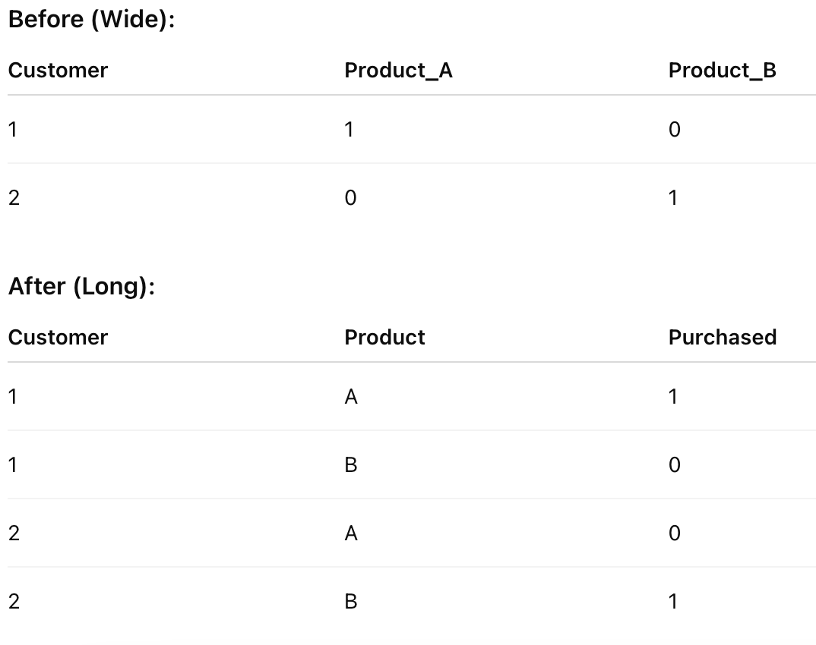
Reshaping
Reshaping is often required for
Plotting
Time-series analysis
Grouped summaries
Melting: Wide -> Long (stack)
Pivoting: Long -> Wide (spread)

Slide 11
Feature Engineering - Making New Variables From Old Ones!
Ratios
debt/income, police/population,
Differences
expected earnings - actual earnings, city poverty - state poverty, individual score - class average
Interactions
exercise * age, income * region, discount * income
Polynomials
age^2…
Categorical Encoding
one hot, ordinal, mean value*, frequency,
Spatial / Geographic
Distance, urban/rural dummy, regional dummies
Text
word counts, sentiment scores…lots of tricky stuff
Aggregation / Grouping
mean, median, variance, etc. by category
Dimensionality Reduction
PCA, factor analysis, etc.
Temporal:
day, week, month, hour, night, weekday/weekend, lags, rolling averages, time since an event, seasonal dummies, periodic encoding
Normalizing & Standardizing*

Slide 12
Log, Sqrt, & Box-Cox Transformations
x’ = log(x)
Used when:
Data is strongly right skewed
Data spans multiple orders of magnitude
Relationships are multiplicative
Likely in: Income, prices, population
x’ = sqrt(x)
Use when:
Data is moderately right skewd
Data is count data
Variance increases with level
Likely in: Number of customers, number of sales

Slide 13
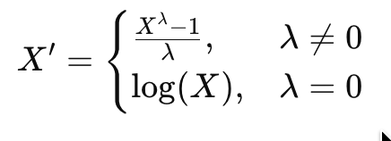
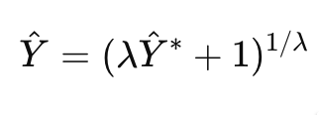
Box-Cox
Box-Cox is a family of power transformations that finds the best way to make data more normal, linear, and/or homoskedastic
Tries many lambda values, transforms the data for each, then chooses the lambda that maximizes log-likelihood and makes data closest to normal distribution
Use when:
Data is right-skewed
Residuals are not normal
Variance is not constant
Transformations are uncertain
Requires all data is positive! Can be addressed by adding a constant to each observation where c > min(x)
Why?
Fixes data that violates model assumptions
Improves prediction accuracy
Issues:
Interpretation is difficult
Must convert back to original scale

Slide 14
Standardizing & Normalizing
Standardizing: Transforming data so it has a mean of 0 and standard deviation of 1
X’ = Z = (X - Mean(X)) / Stdev(X)
Use (sometimes) when variables are on different scales and methods depend on variance structure (PCA, regularization)
Standardizing X and Y for regression gives the interpretation that “a 1 standard deviation increase in X leads to a B standard deviation increase in Y” - These are standardized coefficients
Normalizing: Rescaling numerical values to fit in a common range (often 0 to 1 or -1 to 1)
Shape is preserved but scale is squeezed
Use (sometimes) when bounded inputs or comparable ranges are desired, especially for distance-based models.
For 0 - 1
X’ = (X - Min(X)) / (Max(X) - Min(X))
For -1 - 1
X’ = 2 (X - Min(X) / (Max(X) - Min(X))) -1

Slide 15
Encoding Ordinal and Nominal Data
Ordinal:
If data’s order / rank matters, convert to numerical, but be careful not to compute the same as numerical / continuous data
Example: Turn {High School, Undergraduate, Graduate} to {1, 2, 3}
Note that order matters, but data isn’t quantitative - Graduate is not 1.5x undergraduate and 3x high school
Nominal:
If data are nominal (labels), “one-hot encoding” may be appropriate.
Create a new binary column for each label, but be careful to not introduce perfect multicollinearity
Frequency coding for certain machine learning methods*

Slide 16
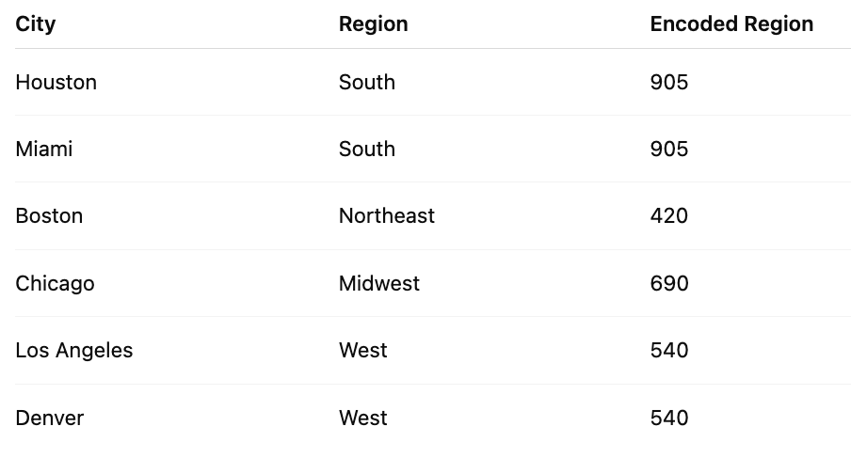

Slide 17
Data Leakage
A model that uses data that would not exist at the time of prediction runs the risk of data leakage
Example: Predicting will student pass exam using hours studied, attendance, and final exam score.
100% accuracy. 0% insightful.
High R^2, High accuracy, Low Error
How to avoid:
Define prediction moment
Use only info available at that moment
Split data before scaling, imputing, PCA, feature selection, winsorizing, etc.
Be careful with aggregation
Keep train and test separate

Slide 18
Leakage Safe Workflow
Define prediction moment
Split data into test and training sets
Fit preprocessing on training data only
Apply the same transformations to the testing data
Train the model
Evaluate on the testing data

